Slide 1
Back To School Night
Mrs. Ruiz
4th Grade

Slide 2
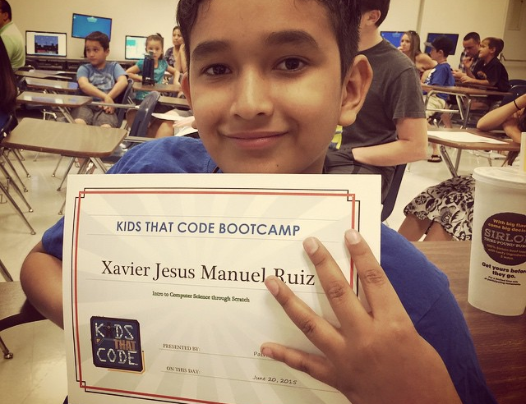
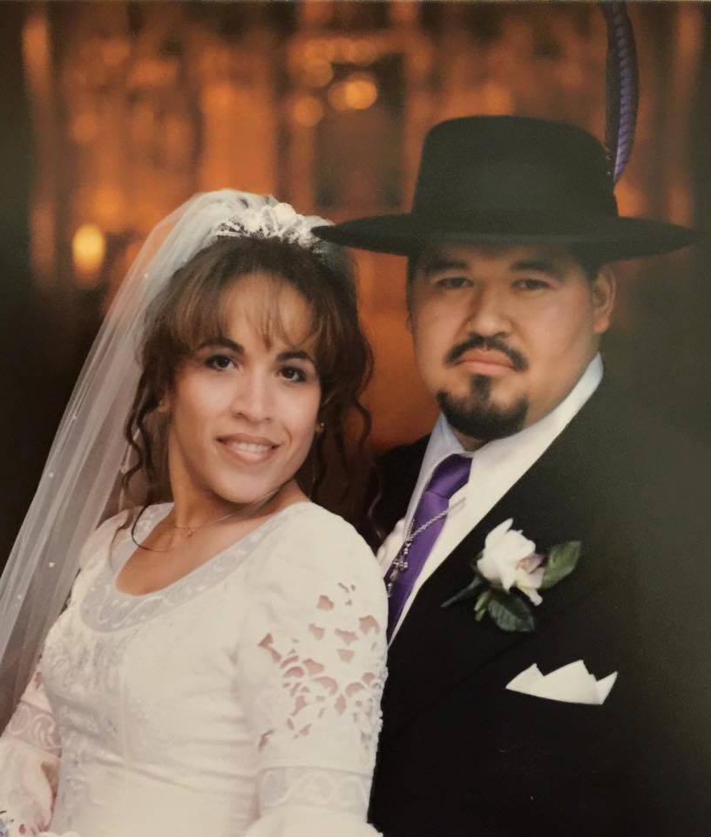
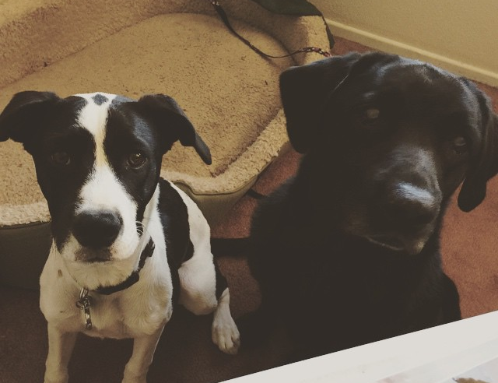
A little about me:
Married Dominick Ruiz in 2001
Had Xavier Ruiz in 2004
Lives in Colton
Fiona = 11 year old Black Labrador Retriever
Dot = 8 month old mixed breed
Teacher since 2000
BA in Business
MA in CLAD
MA in Educational Technology
Nationally Board Certified Teacher

Slide 3

Communication
ClassDojo
Email
Edmodo
Class website

Slide 4

Forms Required
Internet/Email Acceptable Use
Free Lunch Application
School Policy Form
Photo Release Form
Bring Your Own Device Permission Slip

Slide 5
Progress Reports & Report Cards
Progress Reports, twice a year
Report Cards, twice a year
Parent/Teacher Conferences:
  November 2-6, Minimum Days ALL WEEK
  Please bring your child, they are a critical part of our team

Slide 6

Homework
Paperless
MobyMax
No internet or tech at home?
  DGE Computer Labs before or after school
  Public libraries

Slide 7

Calendar of Events
MAPS Testing
PTA Fundraiser
Picture Day: Thursday, September 17th
Scholastic Book Fair: September 21st – 25th
Harvest Festival: October 29th
Fall Break: November 23rd – 27th

Slide 8

Curriculum
StoryWorks
Ready Common Core (RTI)
My Math & DynaMath
Science
Music
History
Health
PE

Slide 9
Classroom Rules
Be honest
Be respectful of others and their property
Be a friend to all
Avoid using inappropriate language
Be on your best behavior
Be on task
Always do your own and best work
Keep your workspace and the classroom neat and clean
Always be mindful of how you move around the room
Always listen to the teacher and follow instructions

Slide 10
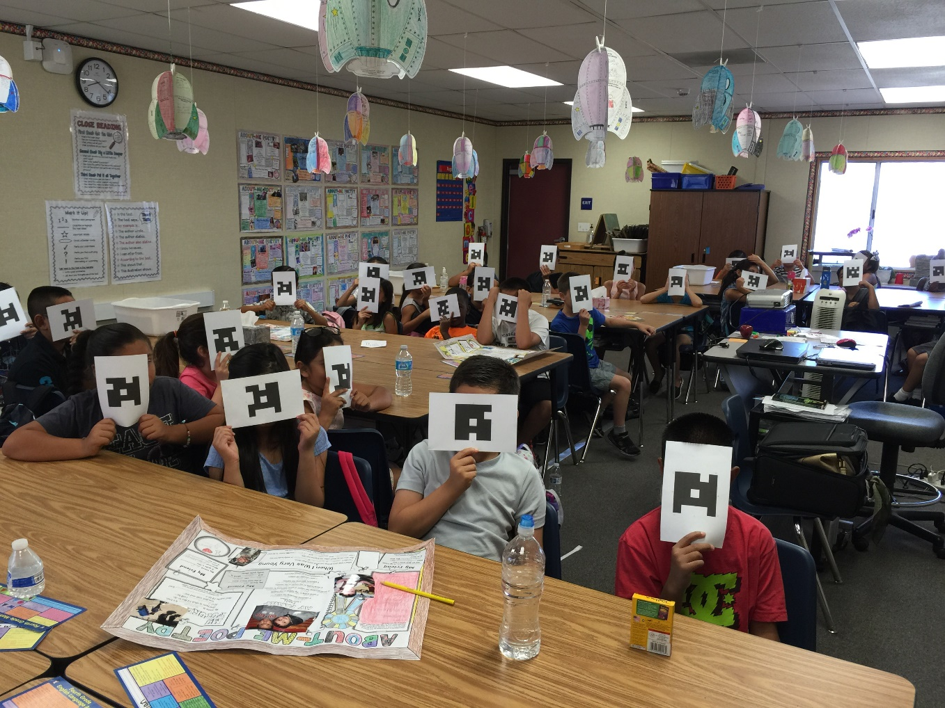
Plickers!

Slide 11
Scholastic Reading Club
Book orders every month
Wide selection
Online ordering (class code: GMXHD)
Purchases earn points toward class items

Slide 12

Technology
iPads
Bring Your Own Device
21st Century Learners & 21st Century Skills
Frequently used programs/apps:
  Edmodo
  MobyMax
  TenMarks
  Lexia
  Accelerated Reader

Slide 13
Thank you for coming to Back To School Night
Questions?
ClassDojo
ruizmy@fusd.net

